Slide 1

Communication in the Workplace
Presented to
Dr. S. M. Nazrul Islam
Associate Professor
Department of Business Administration
NSTU
Presented by
Name : Md Mynuddin
ID : ASH1825007M
Course Code : BUS 3107
BSSE(1st Batch),NSTU,IIT

Slide 2
The Importance of Communication Skills to You
Communication is important to business.
Businesses want and need people with good communication skills that means good communicators. But most people do not communicate well.
By improving your communication ability, you improve your chances for success.
Evidence of the importance of communication in business is found in numerous surveys of executives, recruiters, and academicians. Such as Robert Half survey, NFI research.

Slide 3
Continue..
Whatever position you have in business, your performance will be judged largely by your ability to communicate. If you perform (and communicate) well, you are likely to be rewarded with advancement.
Your message will get lost if it’s not clear, concise and high impact! Get to the point quickly, let the recipient know exactly what you want, and use attention-grabbing techniques whenever possible.
Good communication skills are vital for your success on the job.

Slide 4
Continue
We all know the Fred Devis problem and this actually happened for not having good communication skill.
I think rather than any other skill in the world “Presentation and Communication” Skill is the most Important in any sector.
Suppose I prepared for my exam perfectly , but I cant present my knowledge on the paper and not a good communication with my teacher so result I get automatically bad.

Slide 5
Main Categories of Business Communication
There are three categories of communication in business.
Internal-Operational Communication.
External-Operational Communication.
Personal Communication.

Slide 6
Internal-Operational Communication
Internal operational the communicating done in conducting work “within a business”.
This is the communication among the business’s workers that is done to create, implement, and track the success of the business’s operating plan.
such as giving orders,assembling reports, and writing email.

Slide 7
External-Operational Communication
External operational work related communication with people “outside the business”.
The work-related communicating that a business does with people and groups outside the business is external-operational communication.
This is the business’s communication with it public suppliers, service companies, customers, government agencies, the general public, and others.
Such as personal selling,telephoning, advertising,and writing messages.

Slide 8
Personal Communication
Personal communication non-business/business related exchanges of information and feelings among people.
Personal communication affects employee attitudes.
And attitudes affect employee performance.
The kinds of personal communication allowed and encouraged in the company affect employee attitudes.
Personal communication elements can enhance internal and external business communication.

Slide 9
Communication Networks of the Organization
Two forms of network in an organization
The Formal Network
The Informal Network

Slide 10
Formal Communication Networks
Formal communication represents a network, in which ideas and information flow along the lines of command (The hierarchical levels) in an organization.
Well established , usually along operational line.
Planned and managed.

Slide 11
Informal Communication Networks
Informal communication is a network where two or more individuals (employees) are in contact that does not maintain formal hierarchy of organization.
The informal network, consisting largely of personal communications, is highly complex and ever Changing, dynamic.
It is also term as Grapevine (Secrete means of spreading or receiving information.

Slide 12
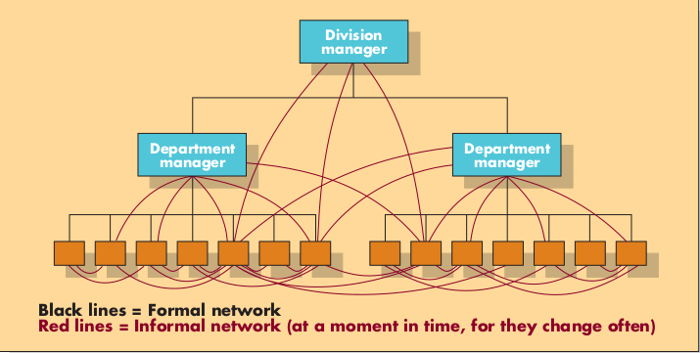
Formal and Informal
Communication Networks

Slide 13
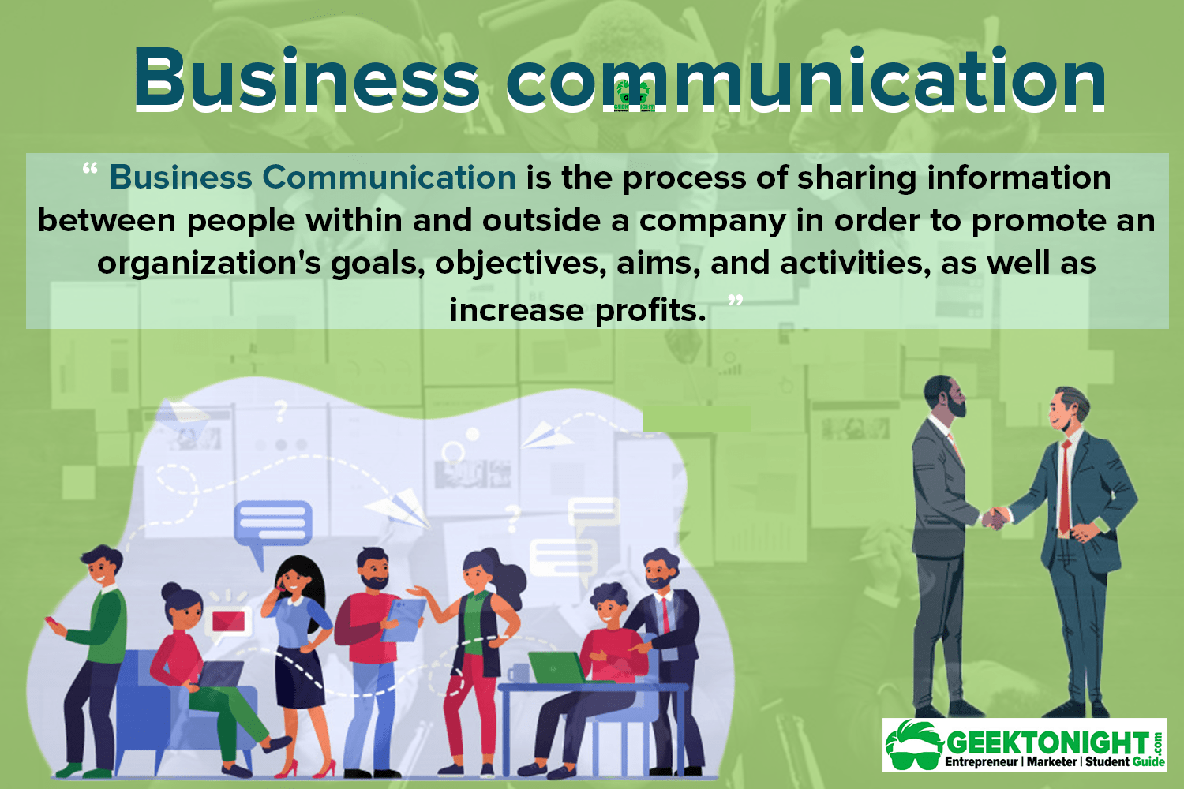
The Business Communication Process

Slide 14
The Business Communication Process
Communicator 1
1. Senses a communication need.
2. Defines the problem.
3. Searches for possible solutions.
4. selects a course of action (message type, contents, style, format,channel).
5.Composes the message.
6.Delivers the message.

Slide 15
The Business Communication Process
Communicator 2
7. receives the message.
8. interprets the message.
9. decides on a response.
10. may send a responding message.

Slide 16
Factors
Affecting the communication in business.
The nature of the business.
Its operating plan.
Its environment.
The geographic dispersion of its members.
Its people.
Its organizational(an organization’s customary, often unexpressed,ways of perceiving and doing things)

Slide 17


